Slide 1
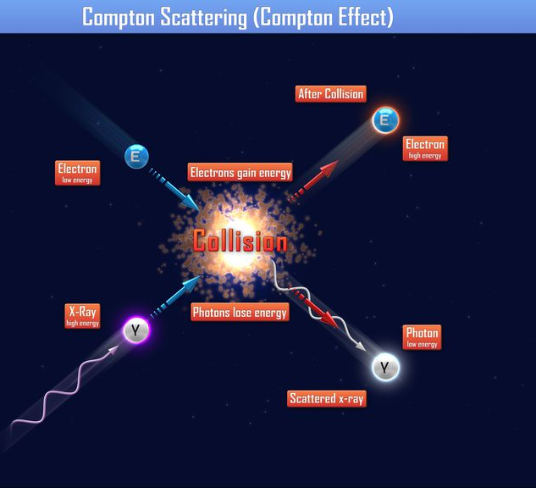
Compton Effect
Xiaoyang Yu
12/12/2019

Slide 2
Introduction
Question: How will a photon interact with an electron?
Classic theory: electron will vibrate at the same frequency as the incident electromagnetic wave, hence radiate new electromagnetic wave with same frequency as the incident wave.
Can we prove the classic theory prediction with an experiment?

Slide 3
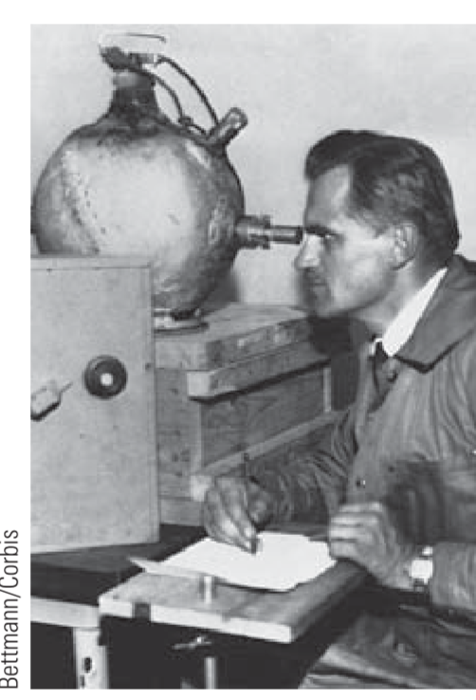
Compton’s experiment
No. Arthur Compton, 1920s
The electron will emit a new photon, with wave length depends on the scattered angle of photon
Strong support to the particle property of photon other than Einstein’s photon electric experiment

Slide 4
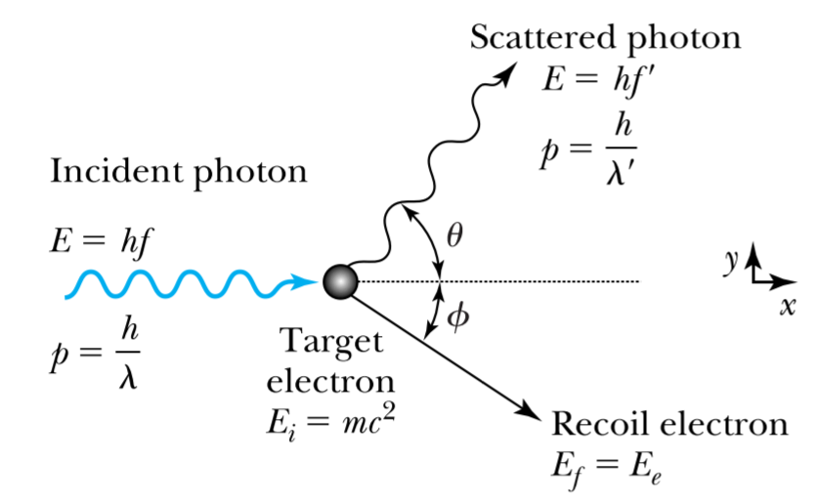
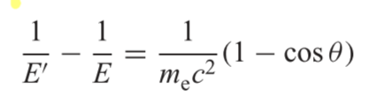
Compton scattering

Slide 5
Experiment
Objective: verify this equation
Using hot radioactive source to get mono-wavelength incident photons
Thanks to Doctor Moeller!
Electrons in an aluminum bar as target
Spectrometer to measure scattered photon energy at different angles

Slide 6
Calibration
For the spectrometer, it won’t report the detected photon’s energy directly, we need to establish a function to convert the reported value to energy
Using a set of well known photon source
Omitted many details…

Slide 7
Result
Scatter angle | Experimental E’ | Expectation E’
120 | 94±100 | 225
90 | 173±100 | 288
75 | 234±100 | 338
60 | 315±100 | 402
45 | 410±100 | 480
30 | 512±100 | 564
15 | 597±100 | 634
At small scatter angles, expectation falls within 1 sigma
At large scatter angles, expectation falls within 2 sigma

Slide 8
Conclusion
At large angles, experiment results are less consistent with expected results.
Large uncertainty, partly due to calibration, partly due to intrinsic uncertainty from the spectrometer measurement
Opinion for improvment: more accurate calibration needed

Slide 9
Reference
PHYS:3756, intermediate lab manual, Compton Effect v_3, the University of Iowa.
Stephen. T.. Thornton, Andre Rex. Modern Physics for Scientists and Engineers, 4th edition, Cengage Learning, 2012.

